Slide 1
STUDENT NAME:=SAKSHI CHOUGULE
COLLEGE NAME:=DKTE Society's Textile & Engineering Institute,Ichalkaranji.

Slide 2
AGENDA
Problem Statement
Project Overview
Who are the End Users?
Advantages
Modeling
Result

Slide 3
AMAZON CLONE APPLICATION
Amazon Clone Script is a top-notch, white-label ecommerce platform solution that empowers you to leverage a universal global base in the shortest turnaround time possible. Drenched with features such as Live Tracking, Lightning Fast Checkout, Price Comparison, Multiple Payment Options etc.

Slide 4
PROBLEM STATEMENT
Online Shopping Cart Script is developed for the business entrepreneurs to make over their business to the online marketing to earn more profit.
Since last a decade buying of products online is becomes trends for the users by getting the user requirements online in their place.
Amazon Script is designed for the offline business vendors to take down their business through online marketing.
Entrepreneurs to kick-start the business through online without any technical background knowledge by using our Amazon Clone.

Slide 5
PROJECT OVERVIEW
Design and User Experience: Once the planning and requirements gathering are completed, the next step is to create a design that is visually appealing and user-friendly. This includes creating wireframes, mockups, and prototypes to test the design and user experience.
Front-end Development: The front-end development involves translating the design into code using HTML, CSS, and JavaScript. This creates the user interface and enables user interaction with the website.
Add the toggle button to the header part to switch from light mode to dark mode and vice-versa

Slide 6
WHO ARE THE END USERS ?
End users in a amazon would typically refer to the individuals who use the platform for online shopping . These individuals could be of any age, gender, or demographic, with varying interests in terms of the type of products they want to shop.
The End Users access the platform either through a website or mobile application, browse through the available options, select the event they are interested in, choose the preferred date and time, and then make the payment to confirm the shopping.

Slide 7
Advantages of Amazon Clone
Major 3 key roles attached with Amazon Clone i.e. Admin, Seller & Buyers
Built with Secure and Powerful Technologies ie. PHP & Mysql
Easily add each essential details which are mandatory in your website
Money making amazon clone for all key-role players.

Slide 8
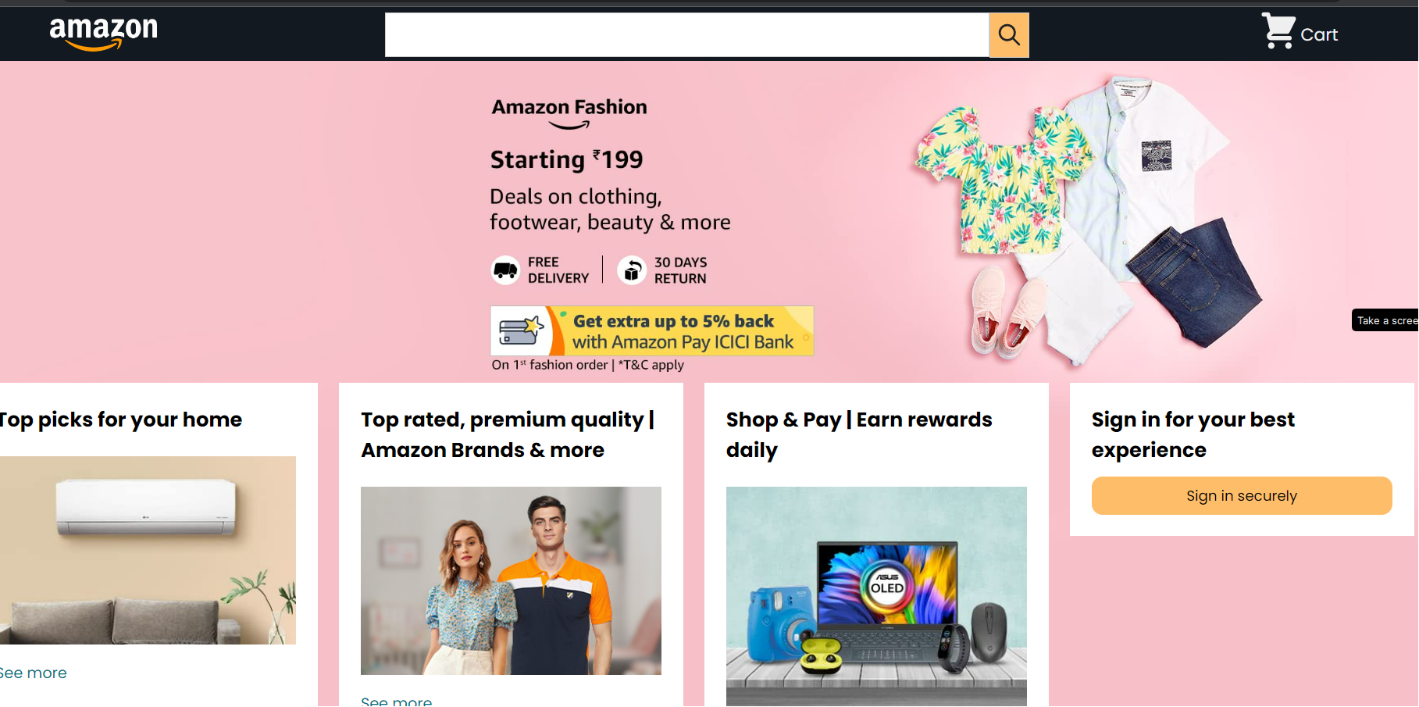
MODELLING

Slide 9
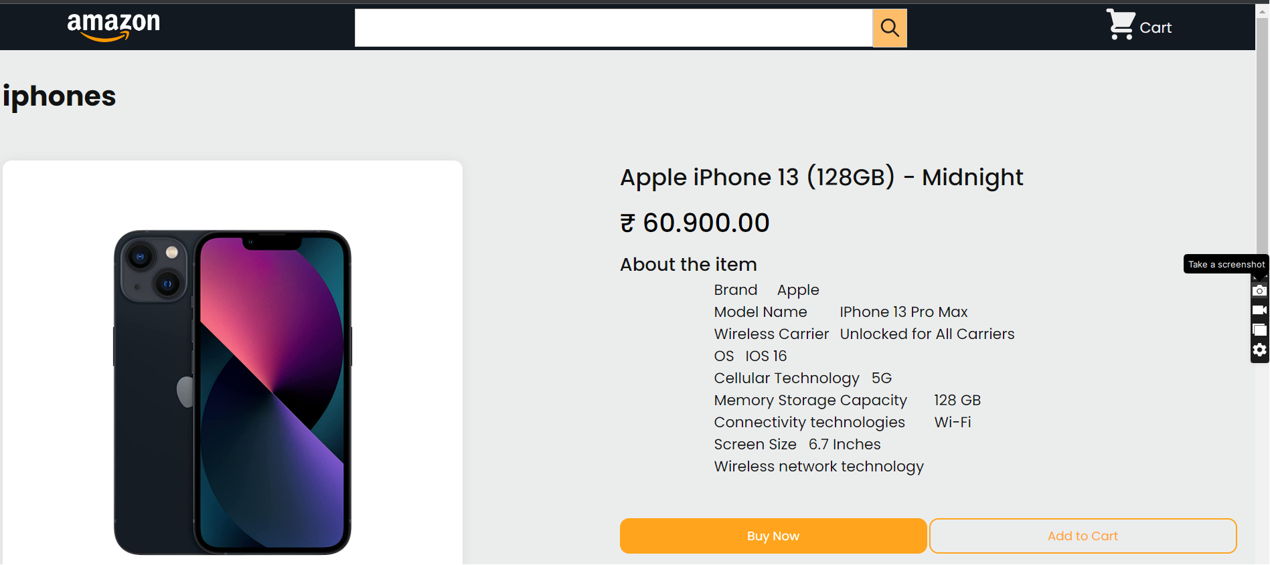
MODELLING
It shows the details about the product when user checks for any product.
In this project, for detailing only one product details used.

Slide 10
RESULT
Amazon Clone is the well-known best e-commerce site for the visitors.

